Slide 1
Binary Classification and Performance Measures
Hira Ilyas

Slide 2
Examples of Binary Classification

Slide 3
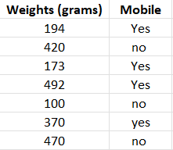
Example 1
Dataset
Given weights calculate the probability that an item whose weight is 378 grams is Mobile. i.e.
b0=28.12 and b1=-0.23.
P(mobile|weight=378)=?
Formula: y = e^(b0 + b1*x) / (1 + e^(b0 + b1*x))

Slide 4
Example 2 - Churn Prediction
Churn is defined in business terms as ‘when a client cancels a subscription to a service they have been using.’ A common example is people canceling Spotify/Netflix subscriptions.
Churn Prediction is essentially predicting which clients are most likely to cancel a subscription i.e. leave a company based on their usage of the service.
The output in the case of Churn prediction is a simple yes or a no. Therefore, it is a classification problem where you have to predict 1 if the customer is likely to churn and 0 otherwise.
Given a dataset having 16 features, we have to create a binary classification model that predicts whether a customer will cancel the subscription in the coming days.

Slide 5
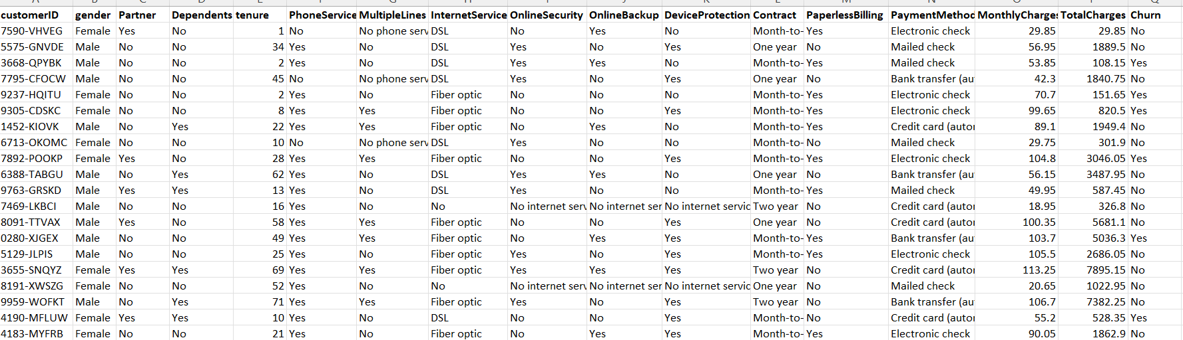
Churn Prediction
Dataset of Churn Prediction

Slide 6
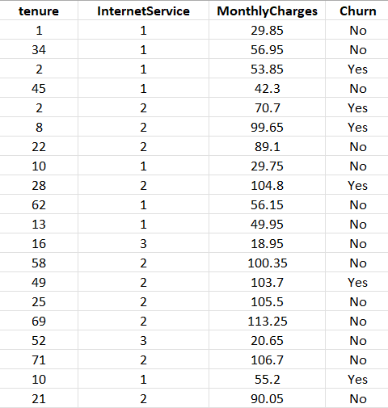
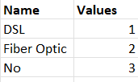
Churn Prediction
After Dataset Preprocessing
For such dataset, what would be my logistic regression formula?
How many coefficients(b’s) should be learned by our model?

Slide 7
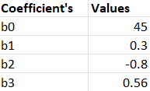
We have learned the coefficients below.
Below is an example logistic regression equation:
y = e^(b0 + b1*x1 + b2*x2 + b3*x3 ) / (1 + e^(b0 + b1*x + b2*x2 + b3*x3 ))
Using the equation above we can calculate the probability of churn given a tenure=24, Internet Service= DSL, and Monthly Charges= 108.34.
More formally P(churn|tenure=24,InternetService=DSL,MonthlyCharges=108.34) = ?

Slide 8
Performance Measures

Slide 9
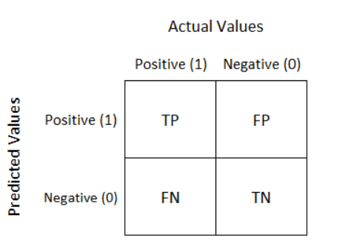
Confusion Matrix
A confusion matrix is a performance measurement technique for Machine learning classification.
It is an N x N matrix used for evaluating the performance of a classification model, where N is the number of target classes.
For a binary classification problem, it is a two-by-two table that contains four outcomes produced by a binary classifier.

Slide 10
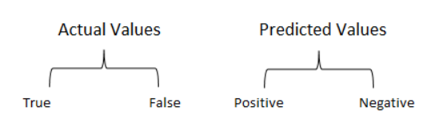
Confusion Matrix
True Positive(TP):
Interpretation: You predicted positive and it’s true.
You had predicted that France would win the world cup, and it won.
True Negative(TN):
Interpretation: You predicted negative and it’s true.
You had predicted that England would not win, and it lost.
False Positive(FP): (Type 1 Error)
Interpretation: You predicted positive and it’s false.
You had predicted that England would win, but it lost.
False Negative(FN): (Type 2 Error)
Interpretation: You predicted negative and it’s false.
You had predicted that France would not win, but it won.
Just Remember, We describe predicted values as Positive and Negative and actual values as True and False.

Slide 11
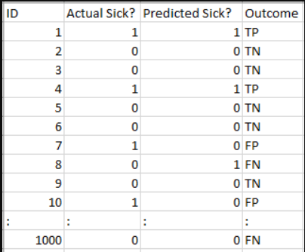
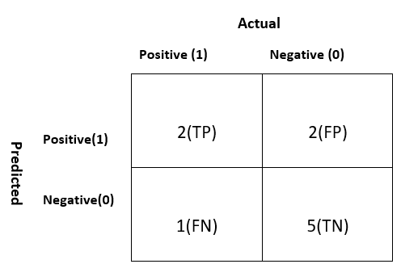
Example 1
Total
4
6
Total
3
7
10

Slide 12
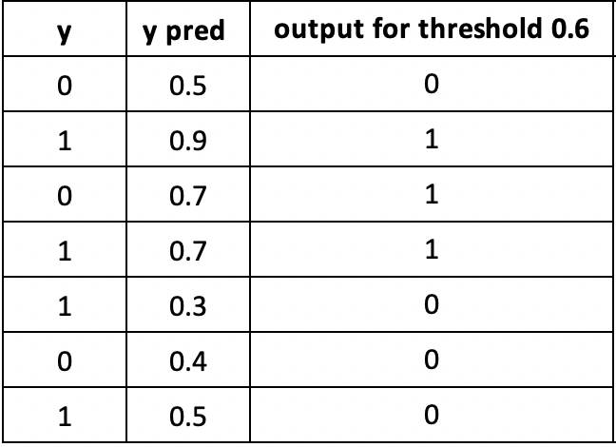
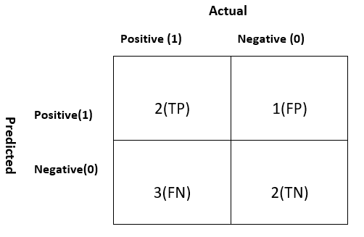
Example 2
TN
TP
FP
TP
FN
TN
FN

Slide 13
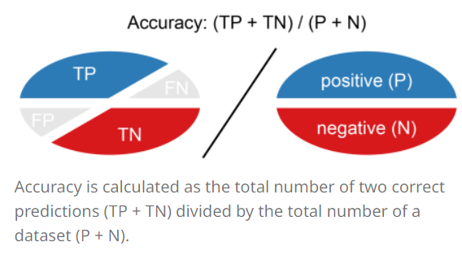
Accuracy
Accuracy (ACC) is calculated as the number of all correct predictions divided by the total number of the dataset.
The best accuracy is 1.0, whereas the worst is 0.0.
Overall, how often is the classifier correct?

Slide 14

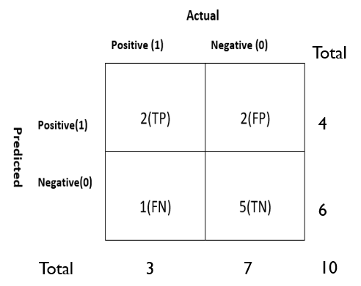
Accuracy(cont)
The accuracy would be calculated by the following formula
ACC= (2+5)/10 = 0.7
So the model is saying I can predict sick people 70% of the time.

Slide 15
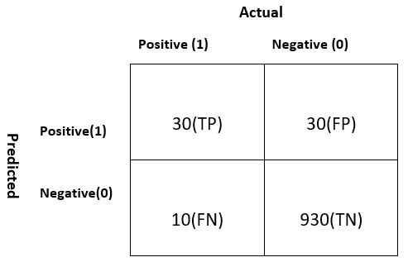
ACCURACY(cont)
Let’s take another example.
Total
ACC=(TP+TN)/P+N = (30+930)/1000 = 0.96
60
Our model is saying “I can predict sick people 96% of the time”.
940
Total
40
960
1000
Notes:
However, it is doing the opposite. It is predicting the people who will not get sick with 96% accuracy while the sick are spreading the virus! Do you think this is a correct metric for our model given the seriousness of the issue? Shouldn’t we be measuring how many positive cases we can predict correctly to arrest the spread of the contagious virus? Or maybe, out of the correctly predicted cases, how many are positive cases to check the reliability of our model?
This is where we come across the dual concept of Precision and Recall.

Slide 16
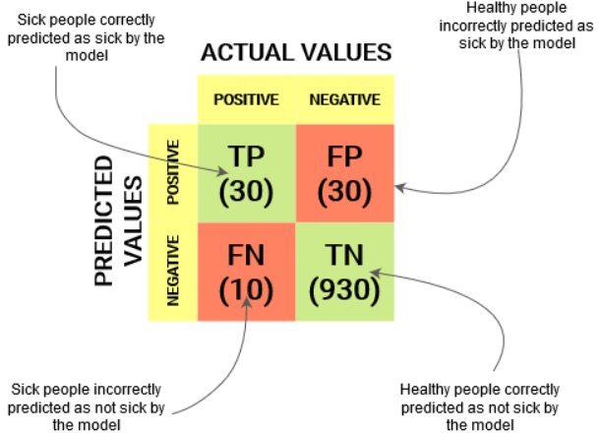
Confusion Matrix

Slide 17
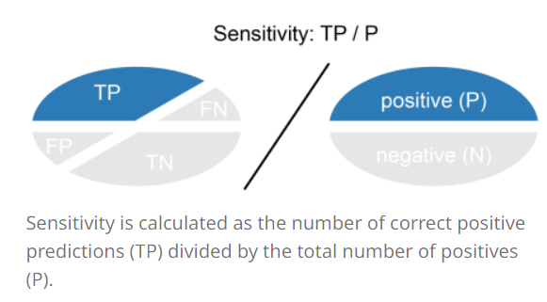
Recall
Recall (REC) is calculated as the number of correct positive predictions divided by the total number of positives.
It is also called sensitivity (SN) or true positive rate (TPR).
The best recall is 1.0, where as the worst is 0.0.
Recall tells us how many of the actual positive cases we were able to predict correctly with our model.

Slide 18
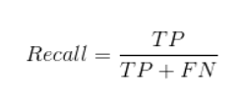
Recall(CONT)
The recall would be calculated by the following formula
Total
60
REC= 30/(30+10) = 0.75
940
75% of the positives were successfully predicted by our model. Awesome!
Total
40
960
1000
Notes:
Recall is a useful metric in cases where False Negative trumps False Positive.
Recall is important in medical cases where it doesn’t matter whether we raise a false alarm but the actual positive cases should not go undetected!
In our example, Recall would be a better metric because we don’t want to accidentally discharge an infected person and let them mix with the healthy population thereby spreading the contagious virus. Now you can understand why accuracy was a bad metric for our model.

Slide 19
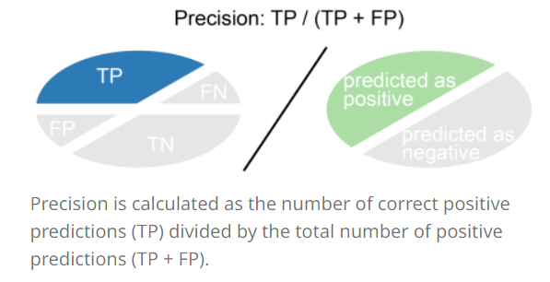
Precision
Precision (PREC) is calculated as the number of correct positive predictions divided by the total number of positive predictions.
It is also called positive predictive value (PPV).
The best precision is 1.0, whereas the worst is 0.0.
Precision tells us how many of the correctly predicted cases actually turned out to be positive.

Slide 20

Precision(cont.)
The precision would be calculated by the following formula
Total
Precision= 30/(30+30)
60
50% percent of the correctly predicted cases turned out to be positive cases
This would determine whether our model is reliable or not.
940
Total
40
960
1000
Notes:
Precision is a useful metric in cases where False Positive is a higher concern than False Negatives.
Precision is important in music or video recommendation systems, e-commerce websites, etc. Wrong results could lead to customer churn and be harmful to the business.

Slide 21
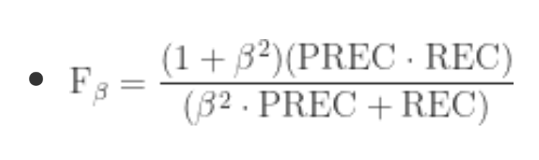
F-score
In practice, when we try to increase the precision of our model, the recall goes down, and vice-versa.
The F1-score captures both the trends in a single value.
F1-score is a harmonic mean of Precision and Recall, and so it gives a combined idea about these two metrics.
It is maximum when Precision is equal to Recall.

Slide 22
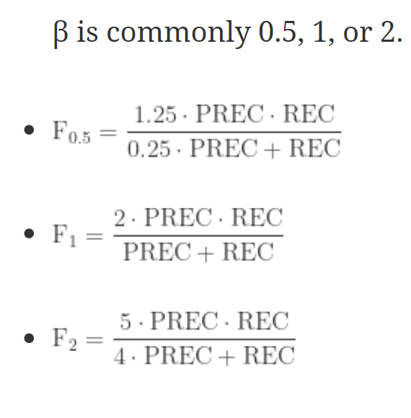
F-score(cont)
Notes:
But there is a catch here. The interpretability of the F1-score is poor. This means that we don’t know what our classifier is maximizing – precision or recall? So, we use it in combination with other evaluation metrics which gives us a complete picture of the result.

Slide 23
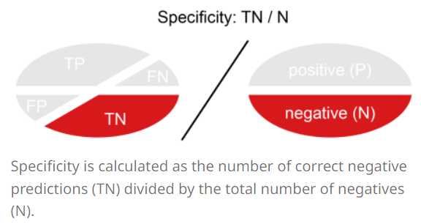
Specificity (True negative rate)
Specificity (SP) is calculated as the number of correct negative predictions divided by the total number of negatives.
It is also called true negative rate (TNR).
The best specificity is 1.0, whereas the worst is 0.0.

Slide 24

Specificity (True negative rate)
The specificity would be calculated by the following formula
Total
60
SP=930/960 = 0.96
940
Total
40
960
1000

Slide 25
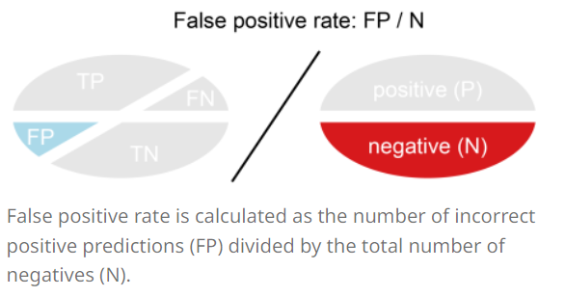
False positive rate
False positive rate (FPR) is calculated as the number of incorrect positive predictions divided by the total number of negatives.
The best false positive rate is 0.0 whereas the worst is 1.0.
It can also be calculated as 1 – specificity.

Slide 26

False positive rate
The specificity would be calculated by the following formula
Total
60
FPR=30/960 = 0.031
940
Total
40
960
1000
Notes:
A higher TNR and a lower FPR is desirable since we want to correctly classify the negative class.

Slide 27
PROBABILITY OF PREDICTION
A machine learning classification model can be used to predict the actual class of the data point directly or predict its probability of belonging to different classes.
We can determine our own threshold to interpret the result of the classifier.
Setting different thresholds for classifying positive class for data points will inadvertently change the Sensitivity and Specificity of the model.
One of these thresholds will probably give a better result than the others, depending on whether we are aiming to lower the number of False Negatives or False Positives.

Slide 28
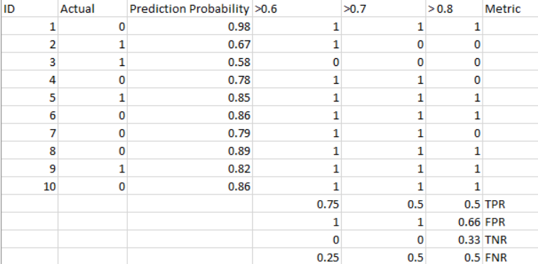
The AUC-ROC curve solves just that problem!
Notes:
The metrics change with the changing threshold values. We can generate different confusion matrices and compare the various metrics that we discussed in the previous section. But that would not be a prudent thing to do. Instead, what we can do is generate a plot between some of these metrics so that we can easily visualize which threshold is giving us a better result.

Slide 29
AUC-ROC Curve
The Receiver Operator Characteristic (ROC) curve is an evaluation metric for binary classification problems.
It is a probability curve that plots the TPR against FPR at various threshold values and essentially separates the ‘signal’ from the ‘noise’.
The Area Under the Curve (AUC) is the measure of the ability of a classifier to distinguish between classes and is used as a summary of the ROC curve.
In a ROC curve, a higher X-axis value indicates a higher number of False positives than True negatives.
While a higher Y-axis value indicates a higher number of True positives than False negatives. So, the choice of the threshold depends on the ability to balance between False positives and False negatives.

Slide 30
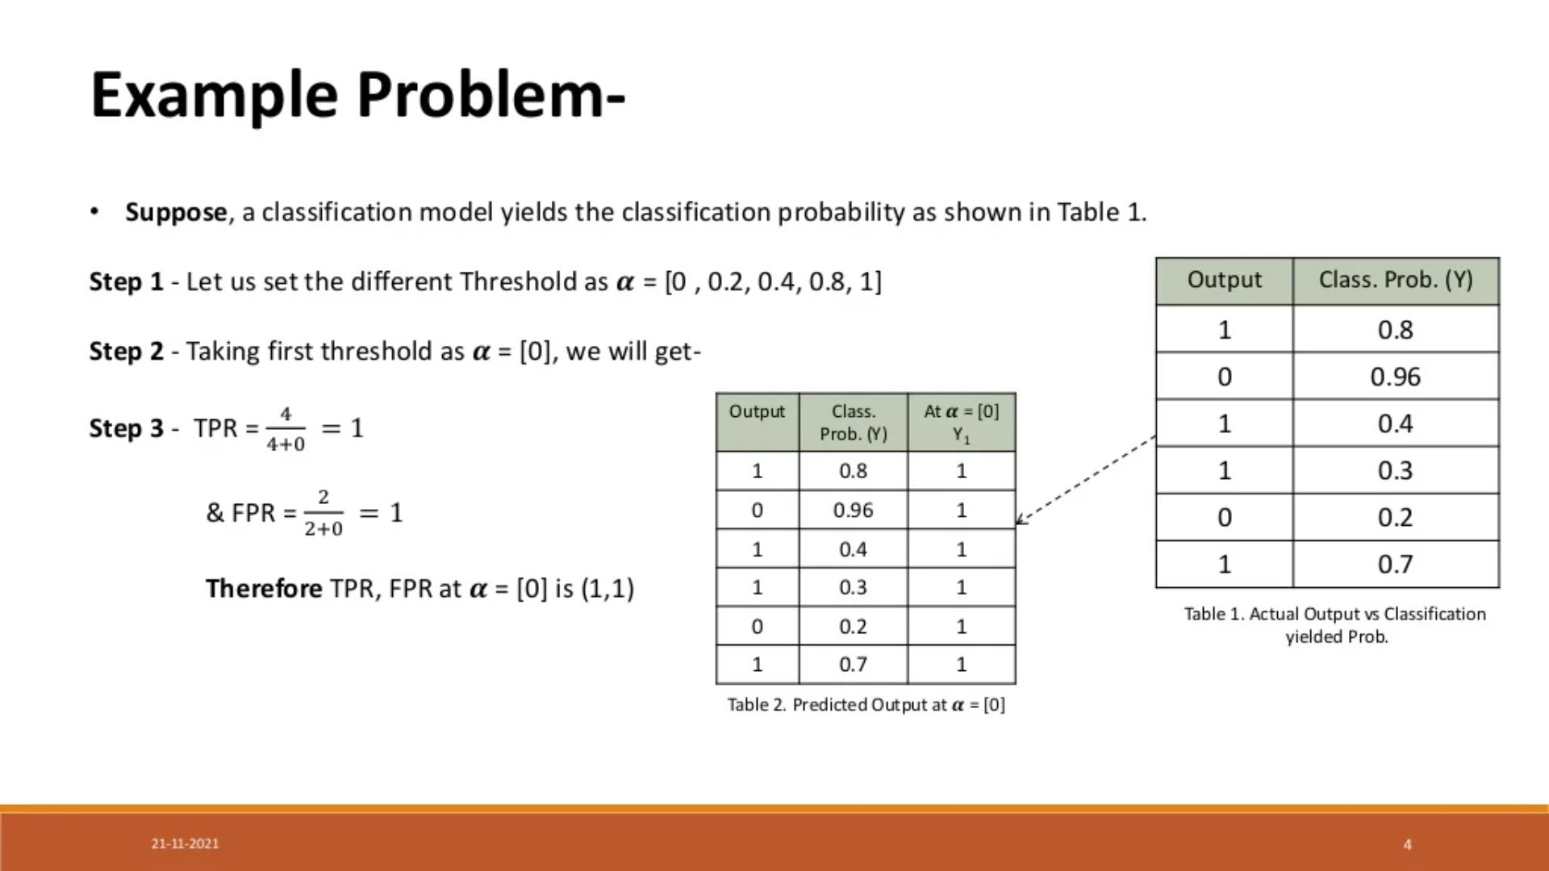

Slide 31
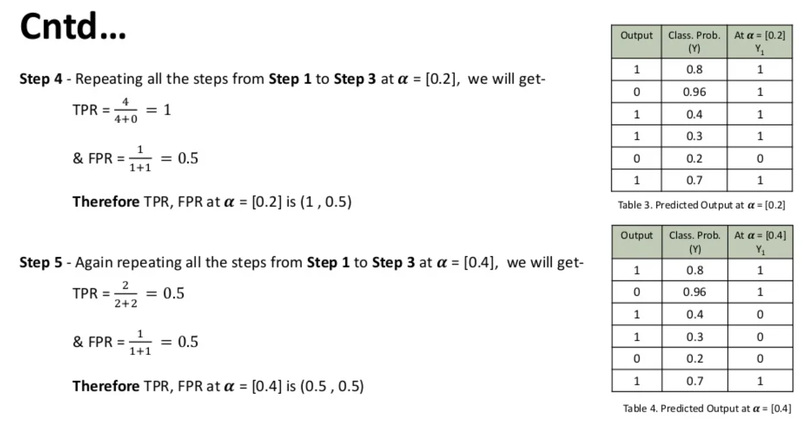

Slide 32
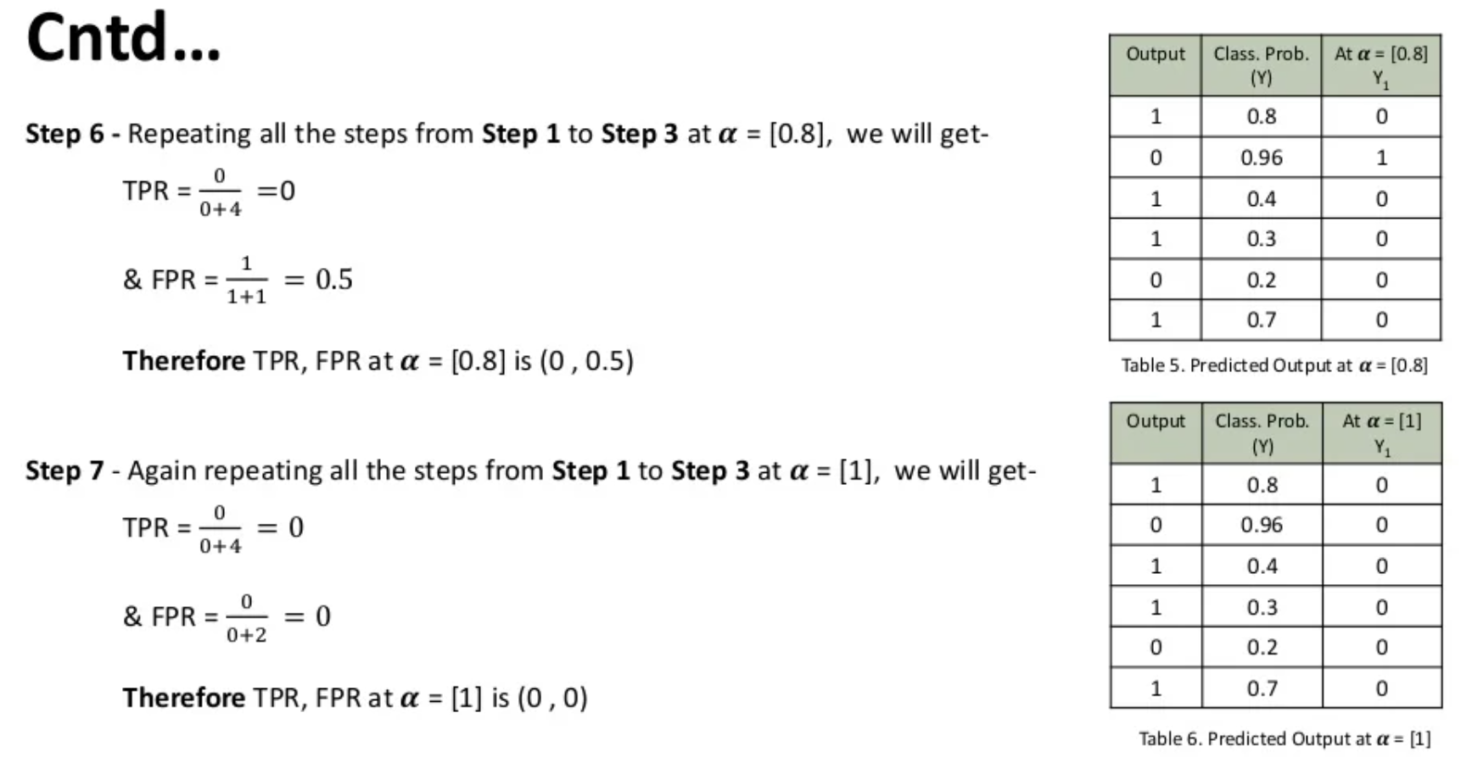

Slide 33
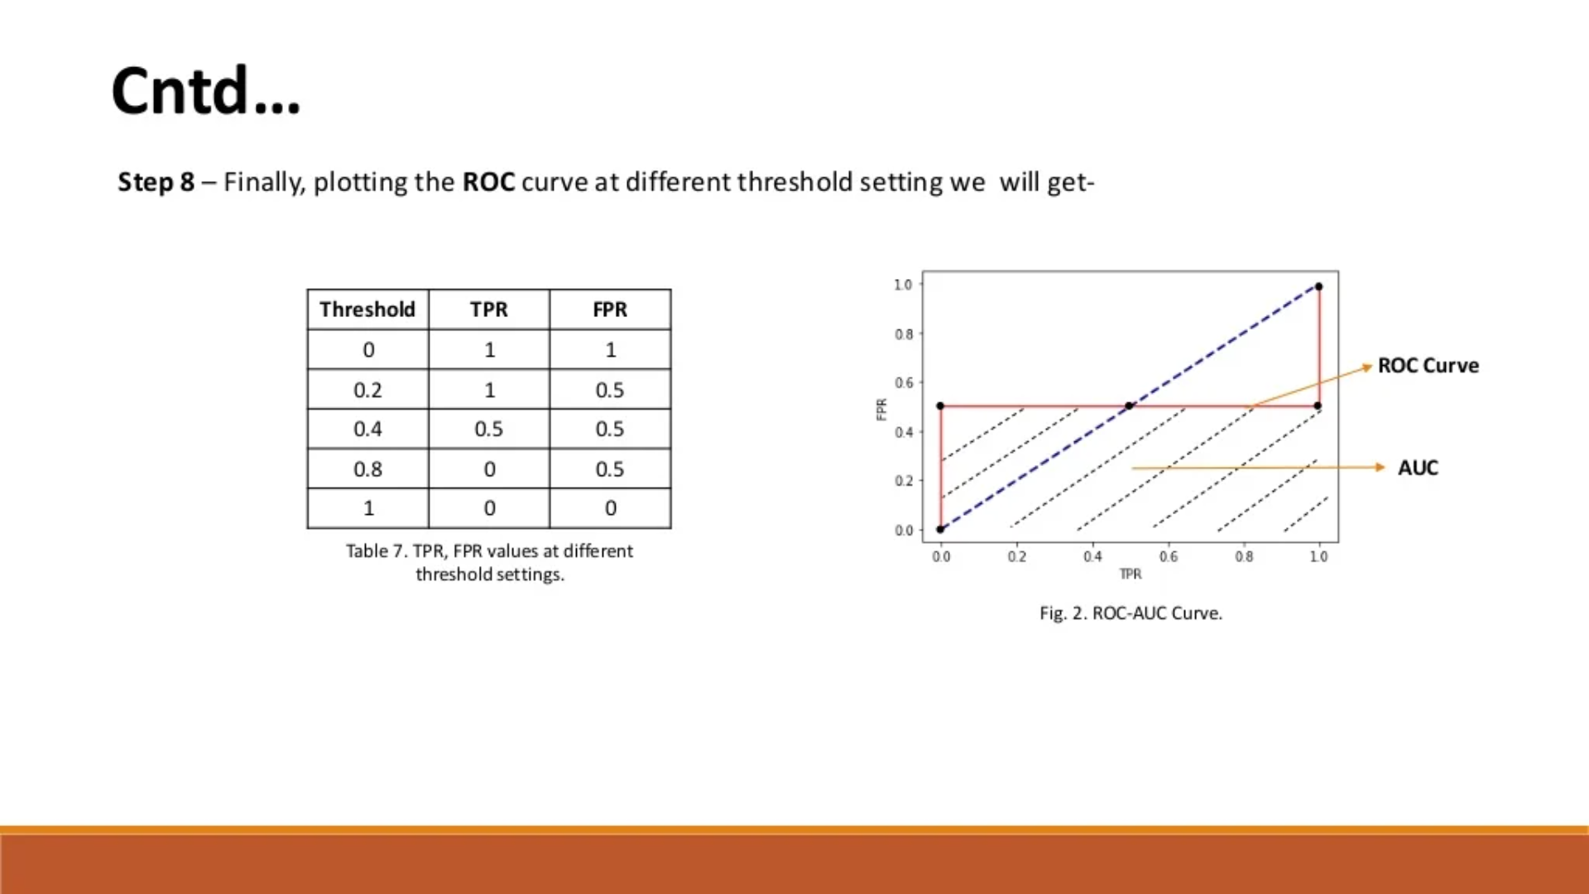

Slide 34
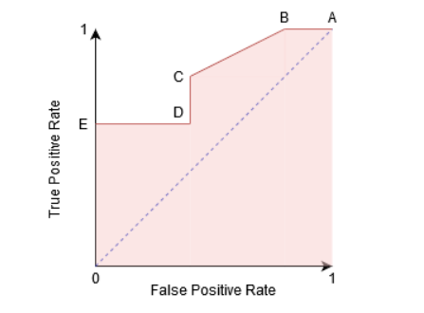
Example 2
Point A is where the Sensitivity is the highest and Specificity the lowest.
Point B has the same Sensitivity as Point A, it has a higher Specificity. Meaning the number of incorrectly Negative class points is lower compared to the previous threshold.
Between points C and D, the Sensitivity at point C is higher than point D for the same Specificity.
Now, depending on how many incorrectly classified points we want to tolerate for our classifier, we would choose between point B or C for predicting whether you can defeat me in PUBG or not.
Notes:
Point A is where the Sensitivity is the highest and Specificity the lowest. This means all the Positive class points are classified correctly and
all the Negative class points are classified incorrectly.
In fact, any point on the blue line corresponds to a situation where True Positive Rate is equal to False Positive Rate
All points above this line correspond to the situation where the proportion of correctly classified points belonging to the Positive class is greater than the proportion of incorrectly classified points belonging to the Negative class.
Although Point B has the same Sensitivity as Point A, it has a higher Specificity. Meaning the number of incorrectly Negative class points is lower compared to the previous threshold. This indicates that this threshold is better than the previous one.

Slide 35
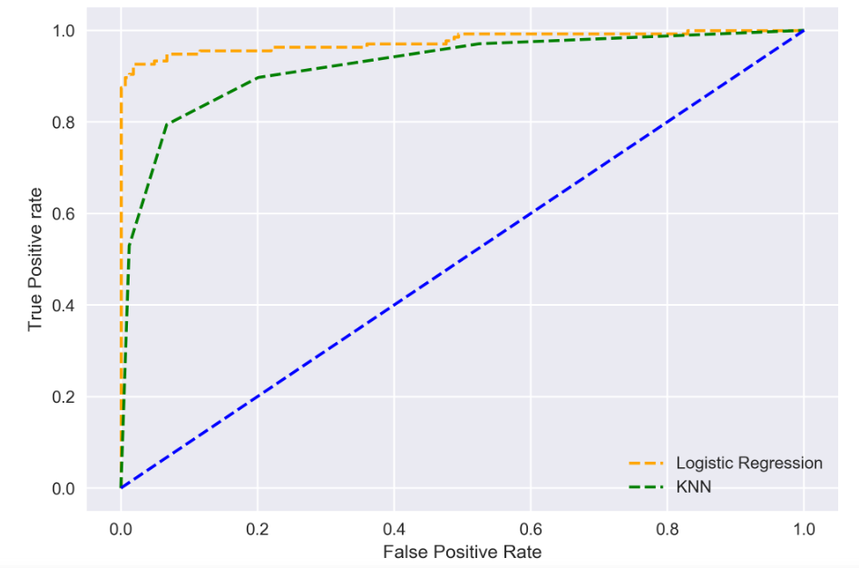
The higher the AUC, the better the performance of the model at distinguishing between the positive and negative classes.
When
AUC = 1
0.5<AUC<1
AUC=0.5
Notes:
When AUC = 1, then the classifier is able to perfectly distinguish between all the Positive and the Negative class points correctly. If, however, the AUC had been 0, then the classifier would be predicting all Negatives as Positives, and all Positives as Negatives.
When 0.5<AUC<1, there is a high chance that the classifier will be able to distinguish the positive class values from the negative class values. This is so because the classifier is able to detect more numbers of True positives and True negatives than False negatives and False positives.
When AUC=0.5, then the classifier is not able to distinguish between Positive and Negative class points. Meaning either the classifier is predicting random class or constant class for all the data points.
So, the higher the AUC value for a classifier, the better its ability to distinguish between positive and negative classes.

Slide 36
Test and train Split
An important decision when developing any machine learning model is how to evaluate its final performance
To get an unbiased estimate of the model’s performance, we need to evaluate it on the data we didn’t use for training.
The simplest way to split the data is to use the train-test split method.
It randomly partitions the dataset into two subsets (called training and test sets) so that the predefined percentage of the entire dataset is in the training set.
Then, we train our machine learning model on the training set and evaluate its performance on the test set. In this way, we are always sure that the samples used for training are not used for evaluation and vice versa.
Usually, we use 80/20 split.

Slide 37
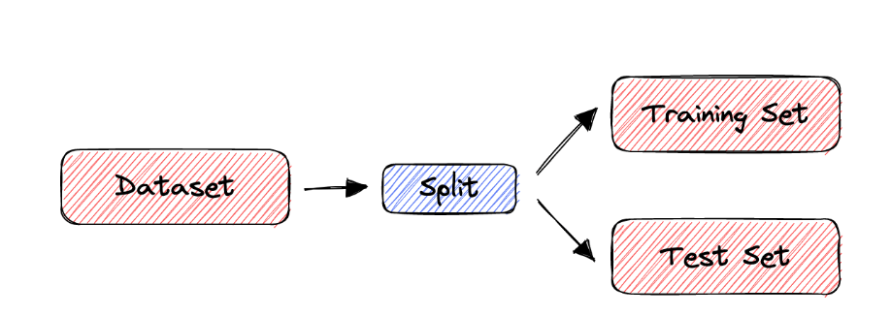
Test and train Split

Slide 38
Cross Validation
The train-split method has certain limitations. When the dataset is small, the method is prone to high variance.
To deal with this issue, we use cross-validation to evaluate the performance of a machine-learning model.
In cross-validation, we don’t divide the dataset into training and test sets only once.
Instead, we repeatedly partition the dataset into smaller groups and then average the performance in each group. That way, we reduce the impact of partition randomness on the results.
Notes:
However, the train-split method has certain limitations. When the dataset is small, the method is prone to high variance. Due to the random partition, the results can be entirely different for different test sets. Why? Because in some partitions, samples that are easy to classify get into the test set, while in others, the test set receives the ‘difficult’ ones.

Slide 39
K-Fold CROSS VALIDATION METHOD
“k-fold Cross-Validation” (e.g., k=10)
randomly partition our full data set into k disjoint subsets (each roughly of size n/k, n = total number of training data points)
for i = 1:10 (here k = 10)
train on 90% of data,
Acc(i) = accuracy on other 10%
end
Cross-Validation-Accuracy = 1/k Σ_{i} Acc(i)
choose the method with the highest cross-validation accuracy
common values for k are 5 and 10
Can also do “leave-one-out” where k = n

Slide 40
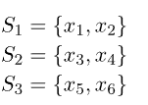

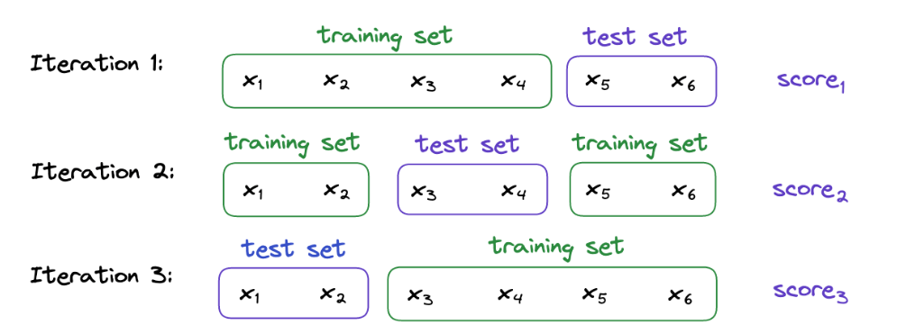
Notes:
For example, let’s suppose that we have a dataset containing 6 samples and that we want to perform a 3-fold cross-validation.
First, we divide into 3 subsets randomly. For instance:
Then, we train and evaluate our machine-learning model 3 times. Each time, two subsets form the training set, while the remaining one acts as the test set. In our example:

Slide 41
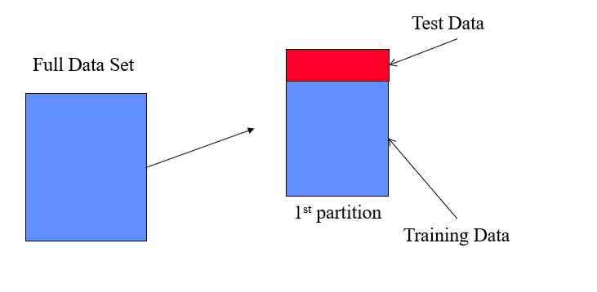

Slide 42
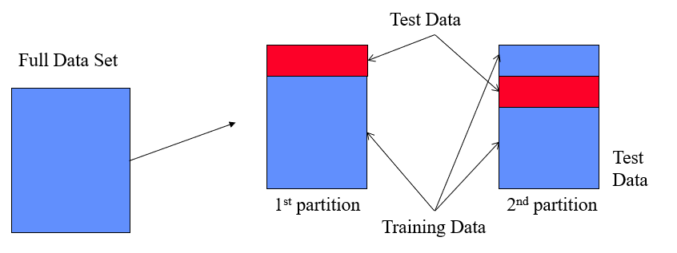

Slide 43
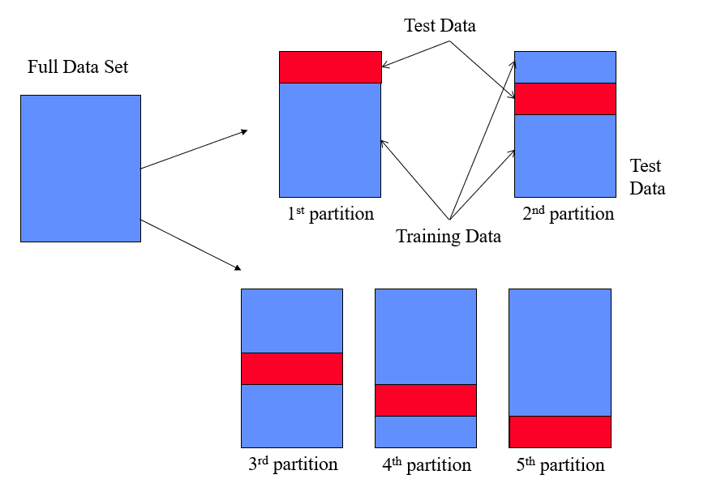

Slide 44
Leave-one-out method
Leave-one-out cross-validation, or LOOCV, is a configuration of k-fold cross-validation where k is set to the number of examples in the dataset.
Each time, only one sample is used as a test set while the rest are used to train our model.
LOOCV is an extreme version of k-fold cross-validation that has the maximum computational cost. It requires one model to be created and evaluated for each example in the training dataset.
Given the computational cost, LOOCV is not appropriate for very large datasets such as more than tens or hundreds of thousands of examples

Slide 45
